Slide 1


INSPERITY · HOLONIC SEMANTIC ARCHITECTURE
The Keel and the North Star
Why one governed semantic layer belongs beneath every AI agent, platform and search at Insperity
Jeffrey Wallk
Notes:
Open with the image, not the architecture. Insperity already navigates by a compass; this deck shows what keeps the ship on that heading. Two audiences in the room: section two is for business executives (value, risk, outcomes), section three is for technical leaders (how it works, how it stays vendor-neutral, how it ships). Everything shown is an illustrative strategic concept, not an Insperity-endorsed plan; figures are planning estimates.

Slide 2
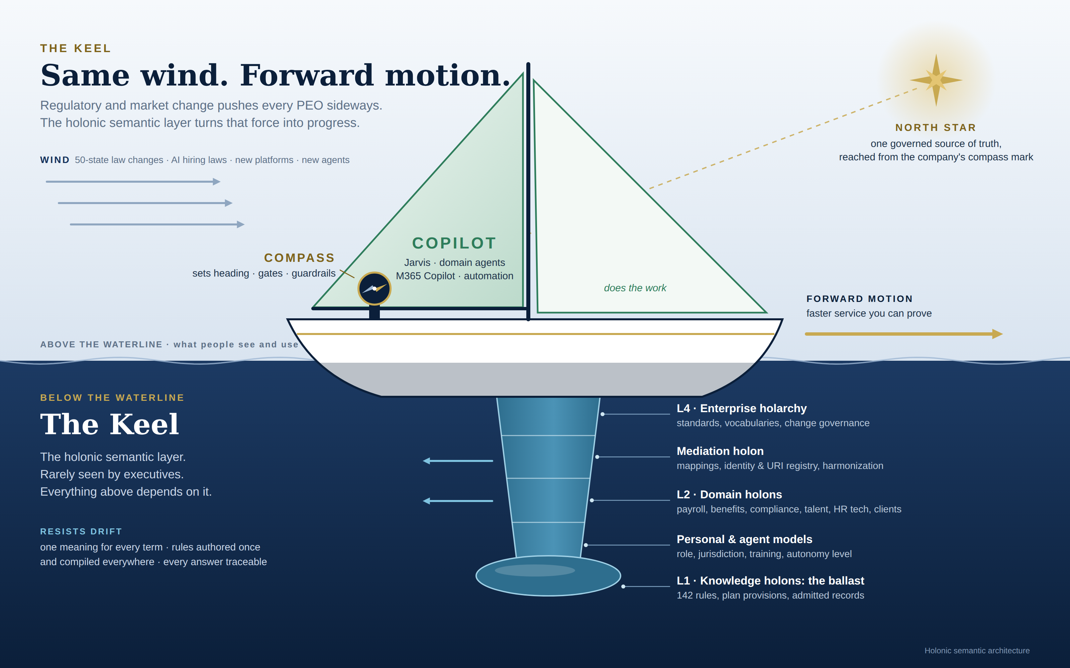
Notes:
This is the whole story in one picture. Compass is the helm: it sets the heading and the guardrails. Copilot is the sails: Jarvis, domain agents and Microsoft 365 Copilot doing the work. The Keel is below the waterline: the holonic semantic layer. Executives rarely see it, yet everything above depends on it. The physics matters: a keel is what lets a sailboat turn a crosswind into forward motion instead of being pushed sideways. For Insperity the wind is regulatory change across 50 states, new AI hiring laws, new platforms like HRScale on Workday, and new agents. Without a keel that force means drift and rework. With one, the same force becomes faster, provable service. The bulb at the bottom is the ballast: L1 knowledge holons, the 142 rules, plan provisions and admitted records that give the whole structure its weight.

Slide 3
THE SITUATION
The wind is already blowing
300K+
50+
142
4+
worksite employees across thousands of client companies
states plus local jurisdictions, each with its own wage, leave and tax rules
rules in the policy register across five service domains
platforms with their own definitions: Workday, payroll, Microsoft 365, Box
Every new platform and every new AI agent brings its own meaning for worker, client, plan and rule. Without a keel, that drift pushes the company sideways.
The Keel and the North Star · 3
Notes:
Ground the metaphor in Insperity's reality. Roughly 300,000 paid worksite employees (per Insperity's 2026 earnings commentary). Every U.S. jurisdiction. A 142-rule policy register across payroll and tax, benefits, compliance and risk, talent, and HR technology. And a platform landscape that keeps growing: HRScale on Workday for the mid-market, Insperity's own payroll and Premier platform, HR360 with its own AI agents, Microsoft 365 for staff, Box for 33 million content records. Each platform and each agent carries its own definition of an eligible employee, a client, a plan year. That is the sideways force.

Slide 4
FOR BUSINESS EXECUTIVES
Three promises the Keel makes
One meaning
Author once, enforce everywhere
Every answer traceable
Worker, client, plan, jurisdiction and rule mean the same thing in Workday, payroll, Microsoft 365 and every agent.
A law change is written once and compiled into every engine that runs the business.
Each payroll check, AI answer and agent action carries the rule and statute behind it.
Reports and AI answers stop disagreeing.
Law change to production: weeks, then 48 hours.
Audit evidence assembled continuously.
The Keel and the North Star · 4
Notes:
For executives, reduce the Keel to three promises. One meaning: the same definitions everywhere, so a Power BI report, a Workday screen and a Jarvis answer agree. Author once, enforce everywhere: legal writes the rule once; it is compiled into payroll tests, gateway policies, Workday configuration and agent guardrails. The planning target is law change to production in 10 days in Phase 1, 48 hours by Phase 3. Every answer traceable: provenance is built in, so CPEO, SOC and ESAC evidence is a query, not a quarterly scramble.

Slide 5
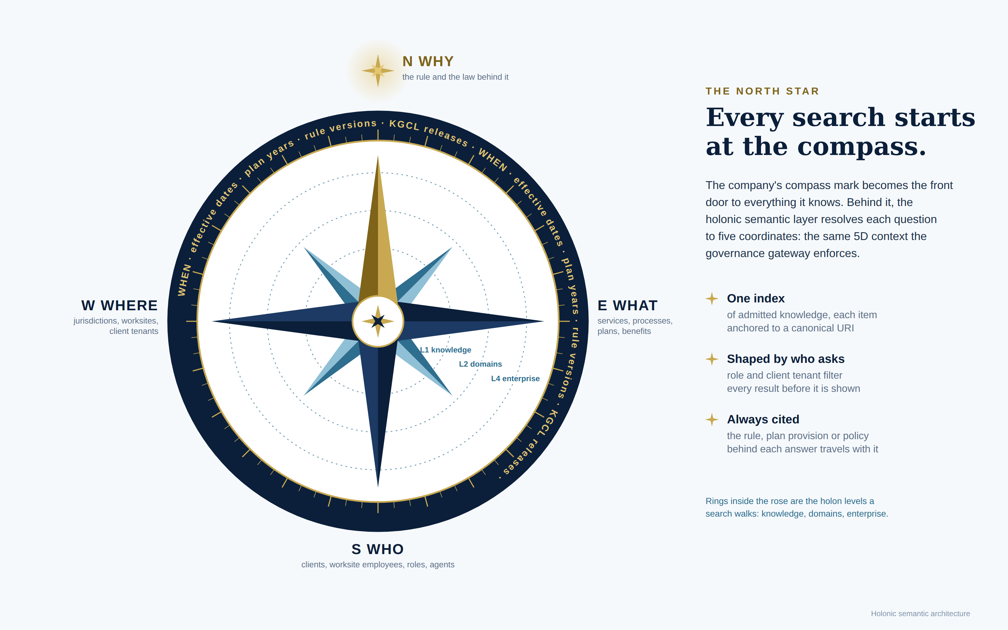
Notes:
The North Star. Insperity's logo was designed as a compass, so it can become the literal front door: tap the mark anywhere, in a portal, in Teams, in Jarvis, and you are searching and navigating the company's governed knowledge. The holonic layer is what makes that possible. Every question resolves to five coordinates, and they are the same five the governance gateway already enforces: WHO is asking, WHAT they need, WHERE (jurisdiction and client tenant), WHEN (effective date, plan year, rule version), and WHY, the north point, the rule and the law behind the answer. The rings inside the rose are the holon levels a search walks. Note: this graphic uses an original compass rose. Swap in Insperity's own mark only with brand-team approval.

Slide 6
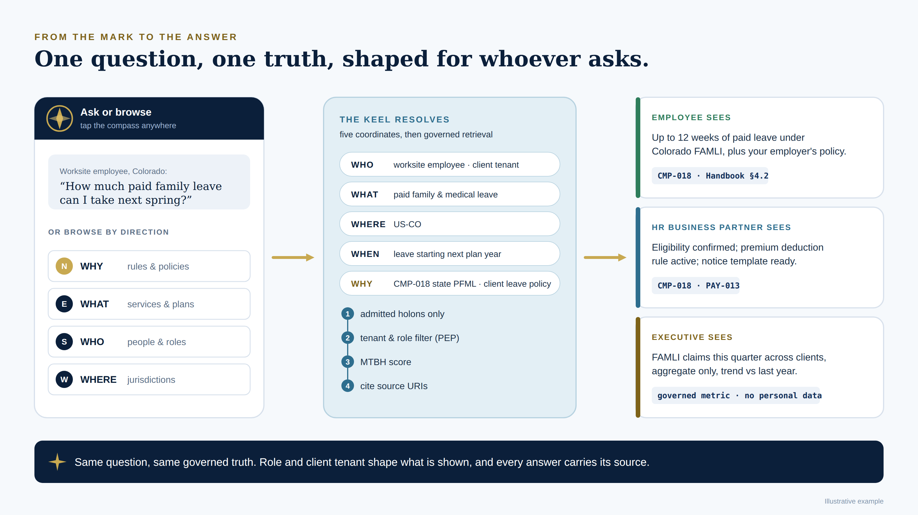
Notes:
Walk one question through. A worksite employee in Colorado taps the compass and asks how much paid family leave they can take. The Keel resolves the five coordinates, retrieves only admitted knowledge, the policy enforcement point removes anything outside that client's tenant and the employee's role, MTBH scores the answer, and the sources travel with it. The same question from an HR business partner or an executive returns a different view of the same truth: the employee sees their entitlement, the HRBP sees eligibility and the payroll rule, the executive sees an aggregate with no personal data. One truth, shaped by who asks. This is illustrative; the figures shown reflect Colorado FAMLI's standard entitlement and should be confirmed against the current register before any demo.

Slide 7
FOR BUSINESS EXECUTIVES
What each group gets
Group | What changes | How we measure it
Worksite employees | Cited pay, benefits and leave answers in seconds; training when a rule changes | Self-service resolution 40% to 80%
Client employers | A monthly Compliance Assurance Statement; law changes applied in days, then hours | Law change to production ≤48 hours
Service teams | Prep, proposals and case summaries grounded in governed knowledge | Proposal prep time index 100 to 50
Insperity enterprise | Continuous CPEO, SOC and ESAC evidence; no client data crossover | Audit-evidence index 100 to 38; zero cross-tenant incidents
The Keel and the North Star · 7 · Targets are planning estimates set against Phase 0 baselines
Notes:
Value, by who receives it. Employees: answers they can trust, with the plan provision cited, and training that arrives when a rule changes rather than once a year. Client employers: a monthly Compliance Assurance Statement, a new, tangible artifact that shows which rules were applied to their workforce and what changed. Service teams: less time assembling, more time advising; the BPA proposal-prep index is a new measure with its baseline set in Phase 0. The enterprise: audit evidence that assembles itself, and zero cross-tenant exposure as a hard gate at every phase. All targets are planning estimates from the program scorecard.

Slide 8
FOR BUSINESS EXECUTIVES
The cost of sailing without a keel
Risk | Without a keel | With the Keel
Agent sprawl | Each vendor's agents answer from their own copy of the truth | Every agent registered, identified and routed through one gateway
Definition drift | Workday, payroll, Fabric and Box each define an eligible employee differently | One canonical definition; the others are generated from it
Audit exposure | Evidence rebuilt by hand before each CPEO, SOC or ESAC review | Evidence emitted continuously, each item tied to its rule
Vendor lock-in | Knowledge trapped in one product's format | Knowledge in open standards; any adapter replaceable within a quarter
The Keel and the North Star · 8
Notes:
Frame the Keel as risk reduction as much as acceleration. Agent sprawl is already arriving: HR360 agents, Copilot Studio agents, Workday agents, each with its own grounding. Definition drift is the quiet cost: the same question answered three ways. Audit exposure grows with every new system that has to be evidenced. And lock-in: if the knowledge lives in one vendor's format, the vendor owns the roadmap. The Keel answers each with a specific control, not a policy memo.

Slide 9
FOR TECHNICAL LEADERS
Inside the Keel: five levels
Level | What it holds | Contract to its neighbours
L4 Enterprise | isp-core, SKOS vocabularies, ORSD templates, governance council | owl:imports federation; KGCL change records
Mediation holon | Mapping graph, identity and URI registry, harmonization, RAG anchors | Six correspondence types; lineage to every projection
L3 Gateway | 5D context bundle, policy enforcement, MTBH circuit breaker, Simplex gate | Every agent call passes one policy decision point
L2 Domain holons | isp-pay, isp-ben, isp-comp, isp-tal, isp-tech, Client, Contractor | Sovereign: own ontology, agent, index and monitors
L1 Knowledge holons | One statute clause, plan provision or policy each | URI, SHACL-valid, KGCL-versioned, bound to its norm
The Keel and the North Star · 9
Notes:
For technical leaders, the key word is contract. Each level has a defined interface to its neighbours, which is what makes the architecture holonic: each domain is a whole in itself and a part of the enterprise. L2 domains are sovereign: adding a sixth or seventh domain never touches the first five. L3 is where Compass runs: every agent call is evaluated against the 5D context bundle, scored by MTBH, and any irreversible action is held by the Simplex gate for a person. L1 is the atomic unit: one clause, one URI, validated and versioned.

Slide 10

FOR TECHNICAL LEADERS
Author once, compile everywhere
dbt / SQL · batch gross-to-net tests
CANONICAL RULE · WRITTEN ONCE
isp-pay:CADailyOvertimeNorm
a lkif:Obligation ;
lkif:isSubjectTo "CA Labor Code §510" ;
isp-core:jurisdiction "US-CA" ;
isp-pay:dailyThresholdHours 8.0 ;
isp-pay:rateMultiplier 1.5 .
OPA / Rego · sub-millisecond gateway policy
JSON Schema · Jarvis and agent constraints
Workday config · validations and conditions
Fabric IQ ontology · analytics and grounding
Every generated artifact carries the source shape URI, so a rejected timesheet points straight to its statute.
The Keel and the North Star · 10
Notes:
The core engineering pattern. Definition time and run time are kept apart. The canonical rule lives in the graph as an LKIF obligation plus a SHACL shape; here, California daily overtime (register rules PAY-005 and PAY-006). The compiler generates the projections the business already runs on: dbt tests over millions of timesheet rows, Rego policies at the gateway, JSON Schema constraints for Jarvis, Workday validations for HRScale clients, and a Fabric IQ ontology for analytics and agent grounding. Nobody hand-edits a projection; drift is detected in CI. The runtime never reasons over the graph, so there is no latency penalty.

Slide 11
FOR TECHNICAL LEADERS
How North Star search works
1 Admit
2 Anchor
3 Resolve
Each item is classified, tagged with its client tenant and PII class, and SHACL-validated before it can be found.
Each admitted item gets a canonical URI, linked to its rules, plans and jurisdictions.
The question becomes five coordinates: WHO, WHAT, WHERE, WHEN, WHY.
4 Retrieve
5 Filter
6 Score and cite
Hybrid retrieval: SPARQL over the graph plus vector search, both keyed on URIs.
The policy enforcement point removes anything outside the asker's tenant or role.
MTBH scores the answer, uncertain ones go to a person, and every answer cites its sources.
The Keel and the North Star · 11
Notes:
Search is not a separate product; it is the Keel exposed as navigation. Nothing is findable until it is admitted, which is what keeps a raw 33-million-record content estate from becoming a hallucination source. Anchoring to URIs means the vector index and the graph agree on identity. Resolution to five coordinates reuses the gateway's 5D context bundle, so search and governance share one model. Tenant and role filtering happens at the enforcement point, not in the prompt. MTBH scoring and citations make every result auditable. On Microsoft this maps to Foundry IQ and Azure AI Search behind API Management; on other stacks the same six steps hold.

Slide 12
FOR TECHNICAL LEADERS
Stack independent by contract
Port | Canonical contract | Microsoft adapter | Alternates
Meaning | OWL 2 · SKOS · LKIF | Fabric IQ ontology (generated) | Neptune · GraphDB
Rules | SHACL · SWRL · KGCL | Fabric/dbt tests · Power Automate | Workday validations · dbt
Policy | OPA/Rego · JSON Schema | API Management + OPA · Purview DLP | Cedar · Envoy
Identity | OIDC · SCIM · URI registry | Entra ID · Entra Agent ID | Okta · Keycloak
Grounding | SPARQL · URI-anchored RAG | Foundry IQ · Azure AI Search | Bedrock KB · pgvector
Agents | MCP · A2A · OpenAPI | Copilot Studio · Foundry Agents | LangGraph · Claude · Workday
Telemetry | PROV-O · OpenTelemetry | Monitor · Sentinel · Purview Audit | Datadog · OpenLineage
Analytics | W3C DPROD | OneLake · Power BI | dbt Semantic Layer · Superset
The Keel and the North Star · 12 · The contract column never changes; adapters do
Notes:
This is the answer to integration and interoperability concerns. The Keel owns contracts, not products. Canonical knowledge lives in W3C and open standards; each vendor surface receives a generated projection carrying the source URI. Microsoft is a first-class adapter set: Fabric IQ, Foundry IQ, Entra Agent ID, Copilot Studio over MCP, API Management, Purview and Sentinel. Purview DLP and Conditional Access stay as the perimeter; the Keel adds controls they cannot express, such as co-employment allocation and per-client knowledge tenancy. Four decisions back this: canonical truth in open standards, enforcement in the request path outside any model vendor, every agent an identity with a governed profile, and one adapter swap exercised at every phase gate. Workday support for MCP and A2A should be confirmed; where absent, Workday agents reach the Keel through the gateway's APIs.

Slide 13
ROADMAP
Four gated phases over 18 months
P0 · Months 1–2
P1 · Months 3–6
P2 · Months 7–12
P3 · Months 13–18
Foundation
Governed Copilot MVP
Domain copilots
Governed autonomy
Keel: isp-core; 142 rules keyed; URI registry; 2,000 assets admitted
Keel: six domain holons; personal models; Workday adapter
Keel: regulatory change discovery; 50 states
Keel: payroll and benefits holons; compiler; gateway
North Star: governed tools in clients' own copilots
North Star: staff search pilot
North Star: cited answers at 3–5 pilot clients
North Star: compass navigator in portals
Gate: SHACL pass ≥98%
Gate: MTBH ≥97% sustained
Gate: P95 ≤3 s; zero cross-tenant
Gate: MTBH ≥96%; 25–40 clients
The Keel and the North Star · 13 · Gates follow the IIH roadmap; no phase opens until the last gate passes
Notes:
The roadmap keeps the four IIH phases and gate criteria, and adds a North Star milestone to each so search and navigation deliver value from the first phase. Phase 0: foundation, and a staff search pilot over the first 2,000 admitted assets. Phase 1: the gateway, MTBH and Simplex are live, and employees at three to five pilot clients get cited answers. Full Gate 1: MTBH WHERE at least 99.5%, WHAT at least 97%, P95 under 3 seconds, trip rate at most 2%, deflection at least 40%, zero cross-tenant incidents. Phase 2: all six domain holons, the Workday HRScale adapter with parity tests, and the compass navigator inside client and employee portals. Phase 3: regulatory change discovery, the 50-state rollout, and Insperity's governed HR tools published over MCP into clients' own copilots, which turns the North Star into something clients carry with them.

Slide 14
NEXT STEPS
Four decisions to start
1 · Review the Architecture
2 · Confirm the Approach & Vision
Align on architecture Design & Principles. Review with technology leadership council and Operations.
Review with Technical Leadership, LOB owners, Procurement on licensing and costs (Design time + Run Time)
3 · Create the Roadmap
4 · Initiate Pilot Phase (Q4)
Work with EA, AI, Analytics, and Operations and PMO. HRScale on Workday and Insperity payroll decide the parity test scope
Define the initial prototype and foundational elements. Align on measurement and change management
The mark already points north. The Keel keeps the company on that heading.
Notes:
Close with decisions, not a pitch. The council is the first dependency: without authority over rule changes, author-once cannot work. The Microsoft footprint determines Phase 0 scope and cost. The platform order (HRScale clients on Workday versus Insperity payroll clients) sets the parity test scope for Phase 2. And the compass mark: making the logo the literal entry point is a brand decision as much as a technical one, and it is what turns the architecture into something every employee and client can see. Final line to leave in the room: the mark already points north; the Keel keeps the company on that heading.

